Slide 1
Demosaicing artifacts

Slide 2
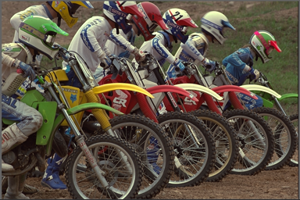


Slide 3



Slide 4




Slide 5



